Slide 1
Maxillofacial Care for Gunshot Patients in Somaliland
Dr. Abdirahim Uurcade
BDS (Pak), FCPS (Pak), FAOCMF (Germany)
Consultant Oral and Maxillofacial Surgeon

Slide 2
Introduction
Ballistic injury patterns to the craniomaxillofacial region present a unique and challenging dilemma for the facial trauma surgeon.
The tissue disruption associated with ballistic injury to the head and neck region can be daunting, and

Slide 3
Introduction
The tissue damage caused by high-velocity bullets results in tremendous soft and hard tissue defects both from immediate damage and progressive die-back phenomenon
The identification of normal anatomic planes, potentially lost within bleeding, destroyed soft and hard tissues

Slide 4
Components of ballistic missiles
The cartridge or round describes a unit of firearm ammunition.
Projectile: the portion of the bullet that is expelled and strikes the target
Casing: container packaging the projectile
Propellant: accelerant that actually allows for expulsion of the projectile from the weapon
Primer: the only portion of the bullet with an explosive charge.

Slide 7
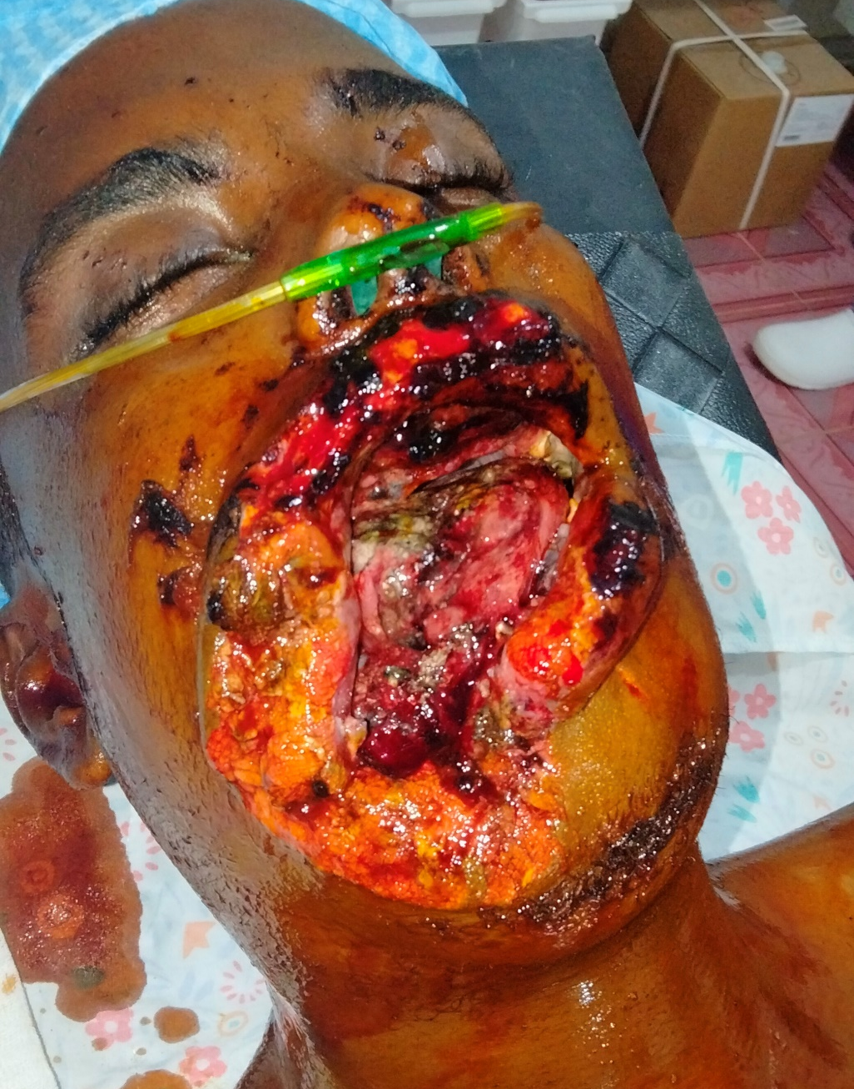

Slide 8
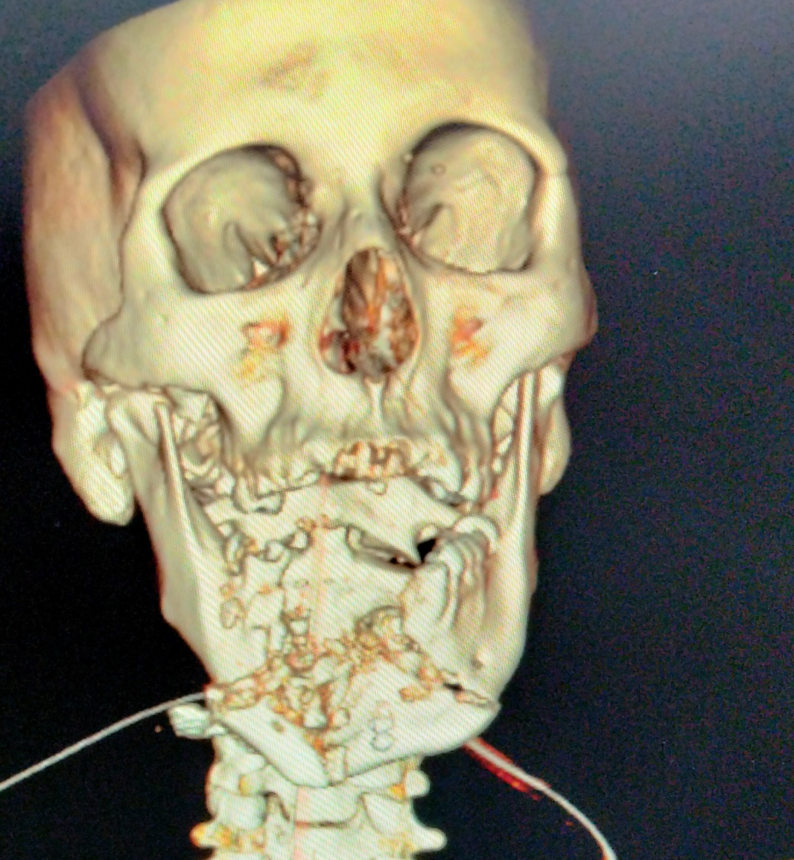

Slide 9
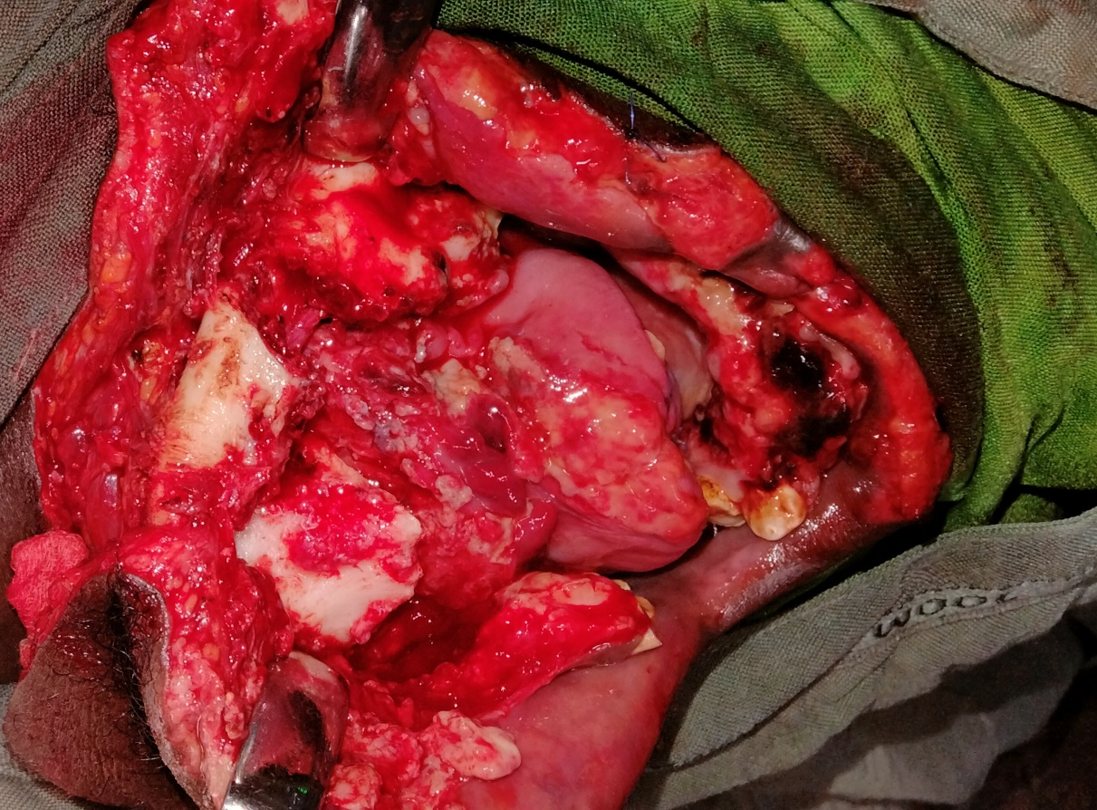

Slide 10
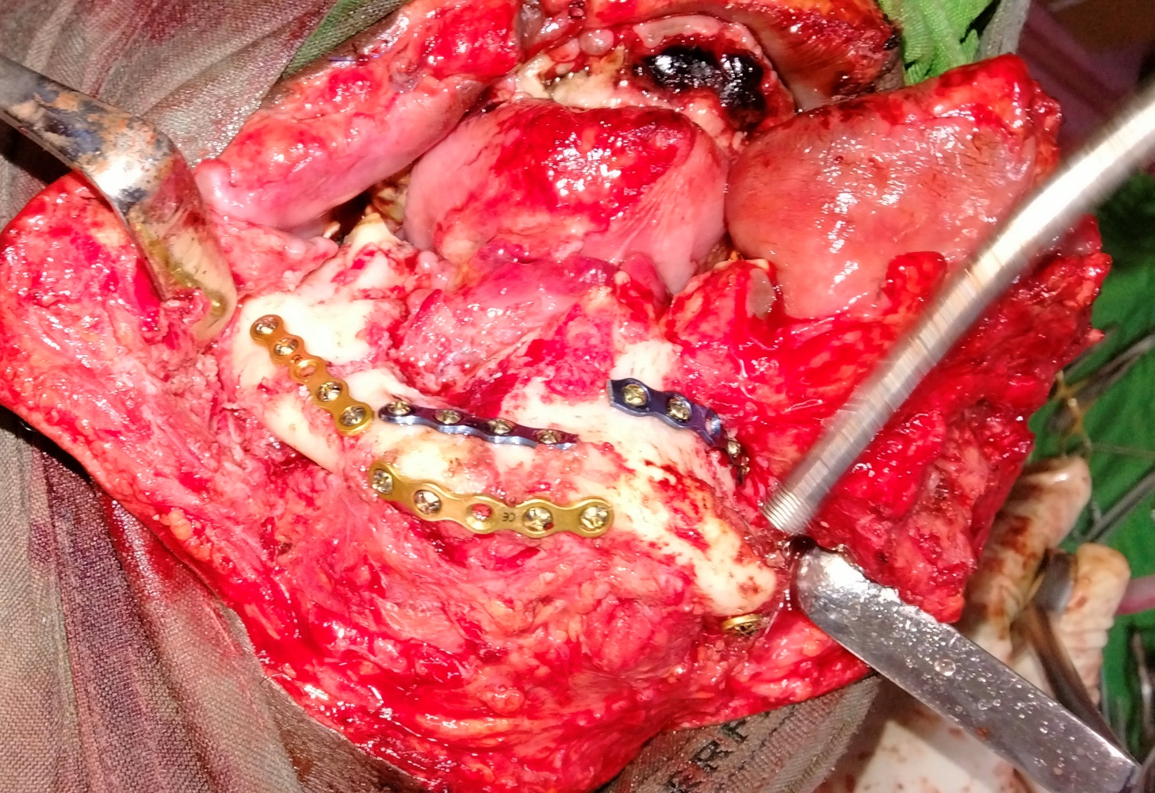

Slide 11
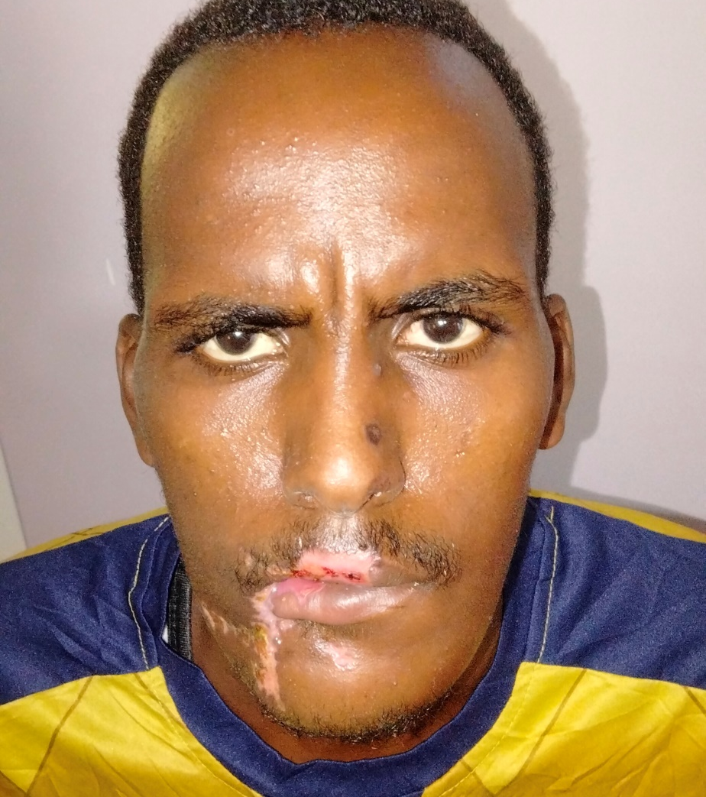

Slide 12
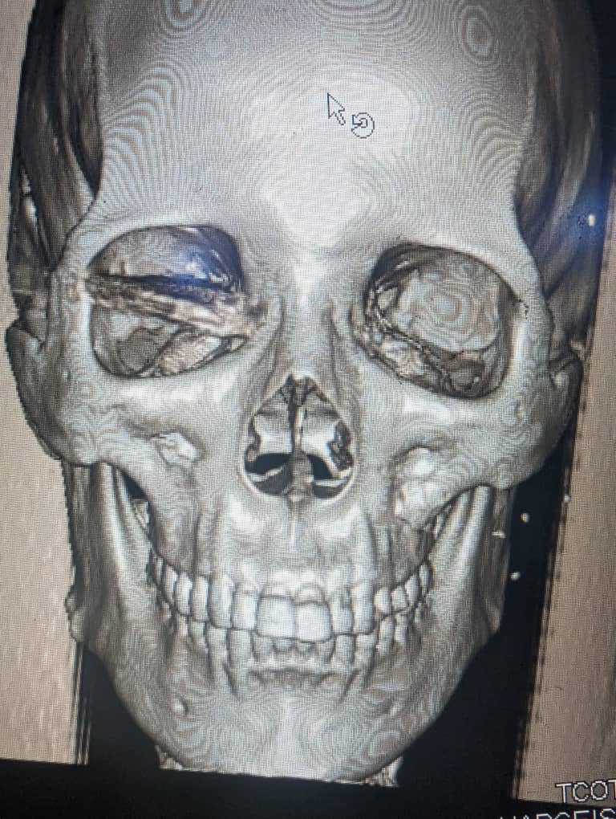

Slide 13
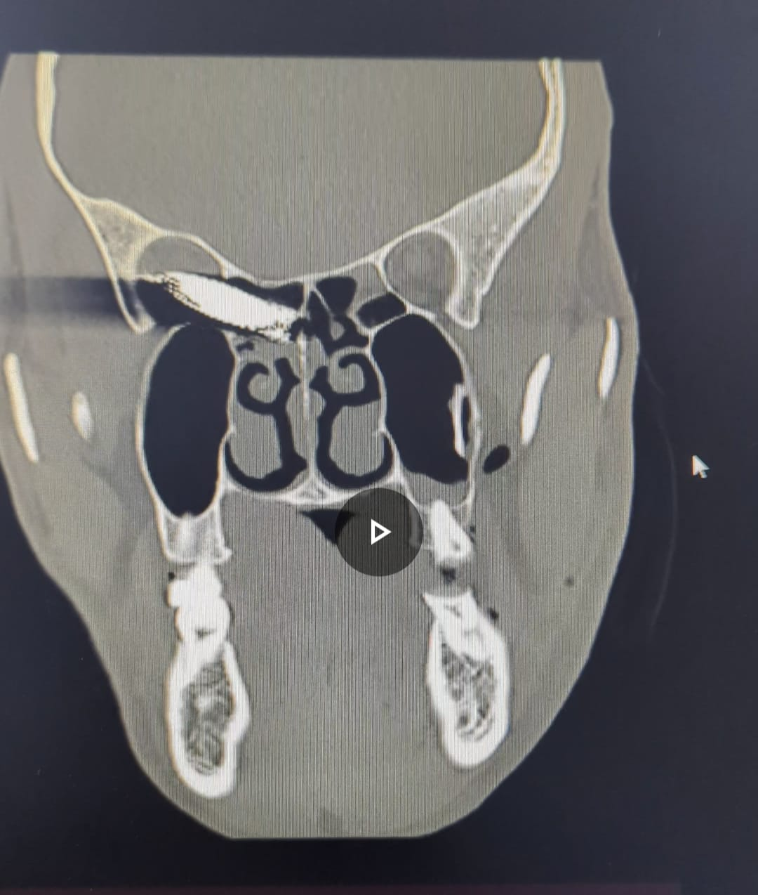

Slide 14
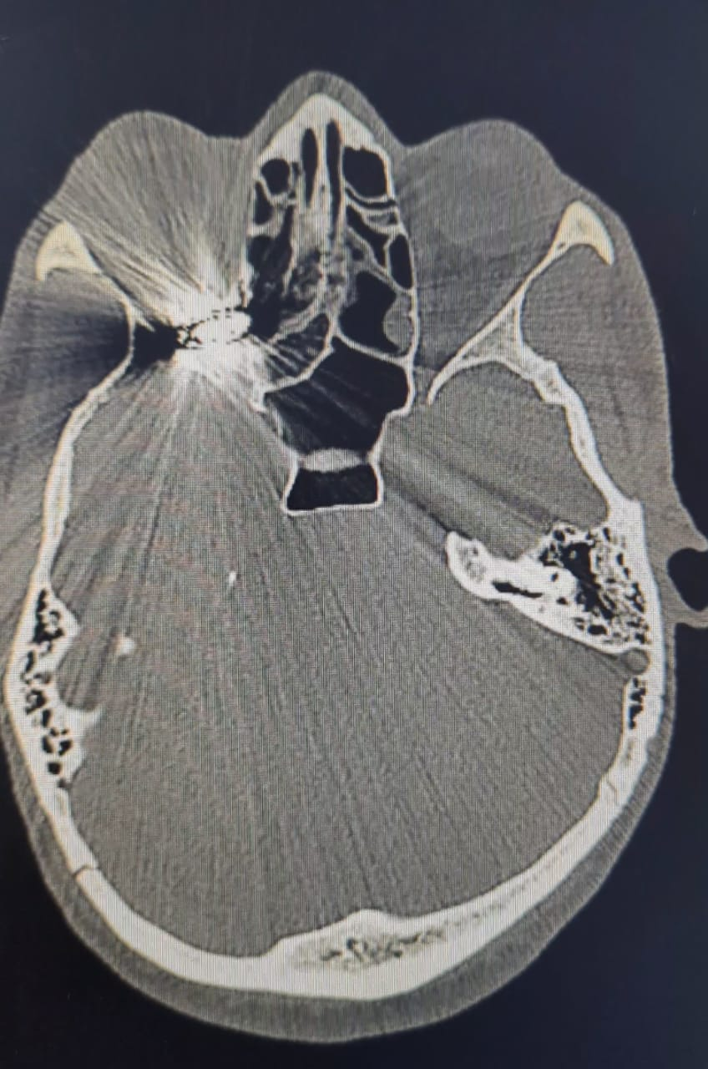

Slide 15
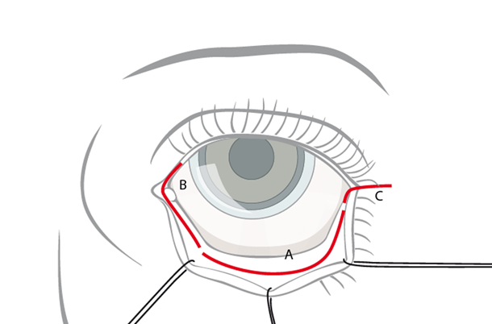

Slide 16
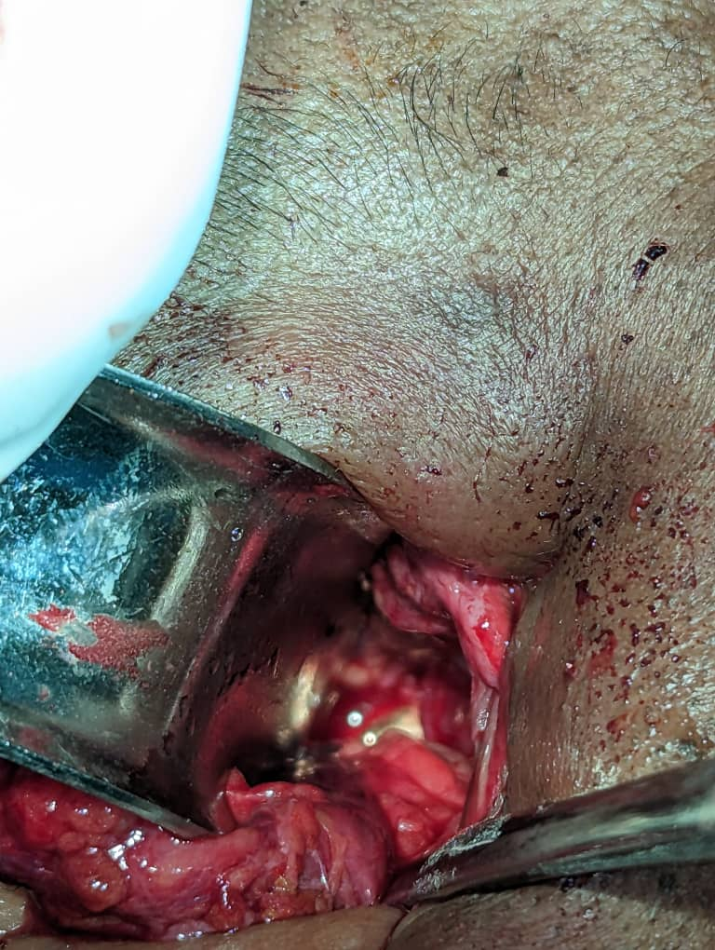

Slide 17
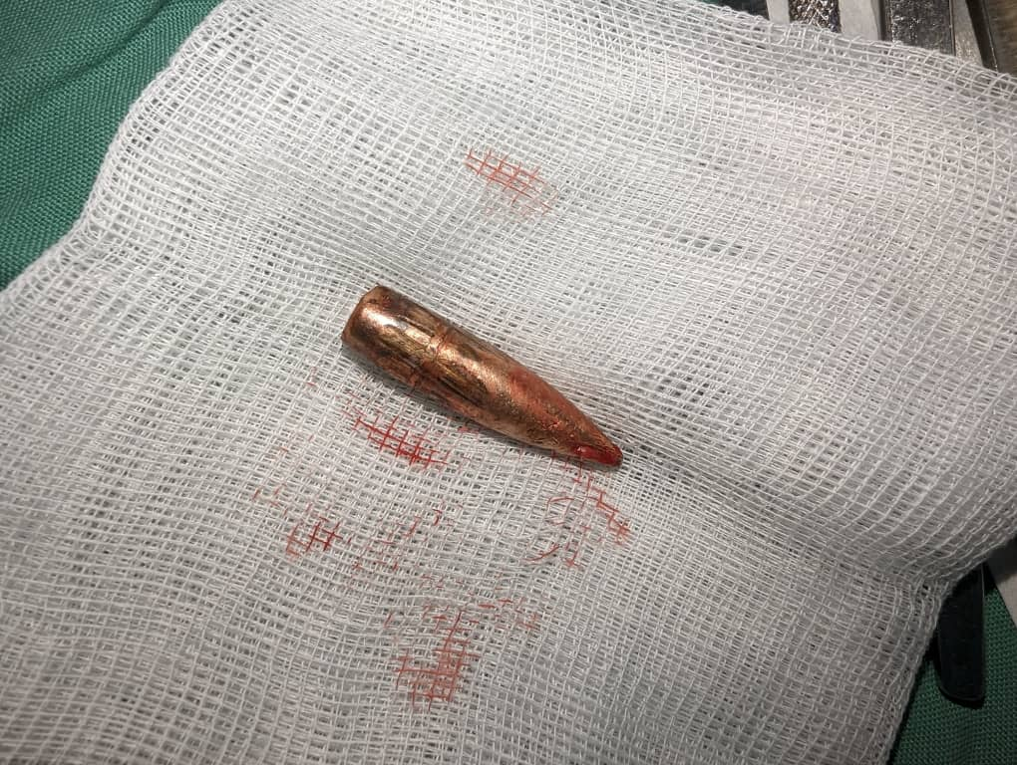

Slide 18
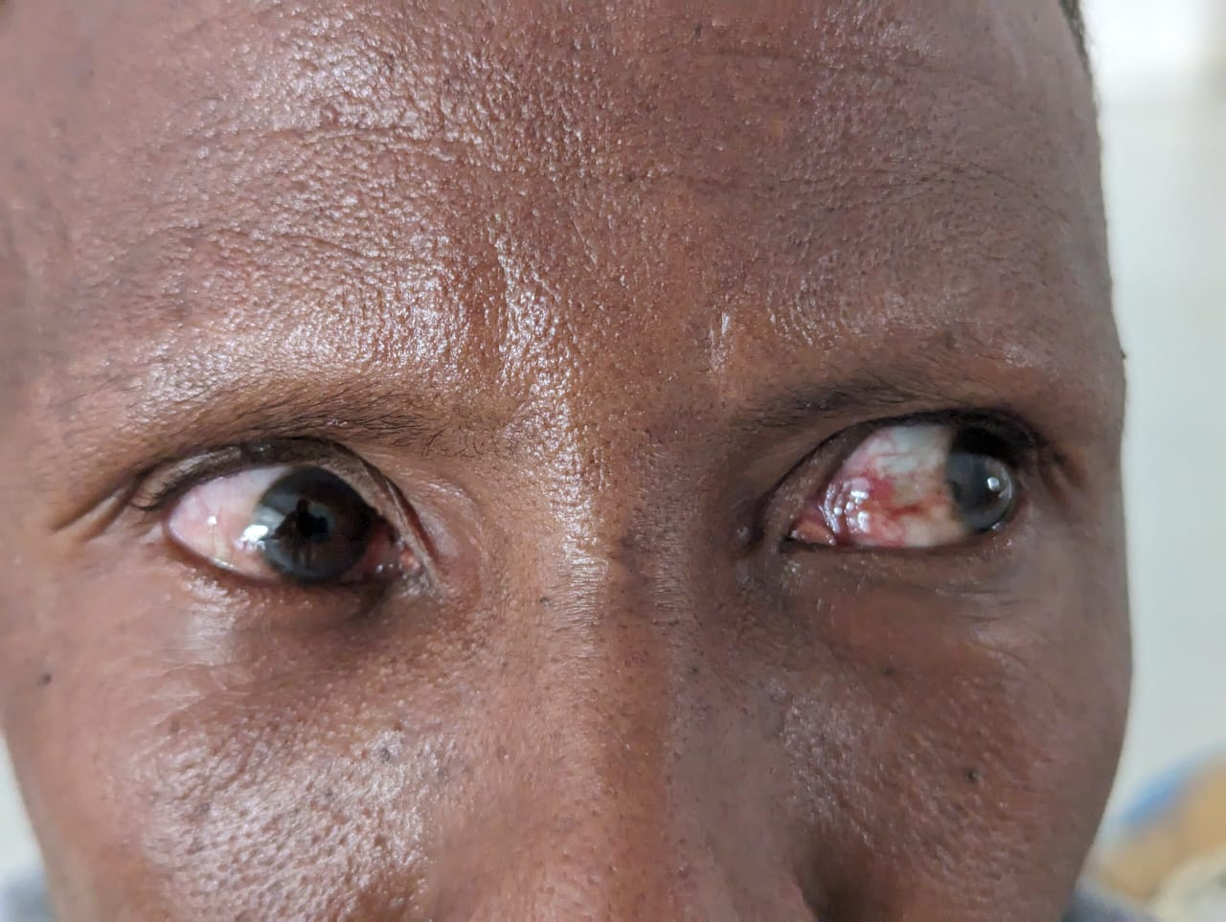

Slide 19
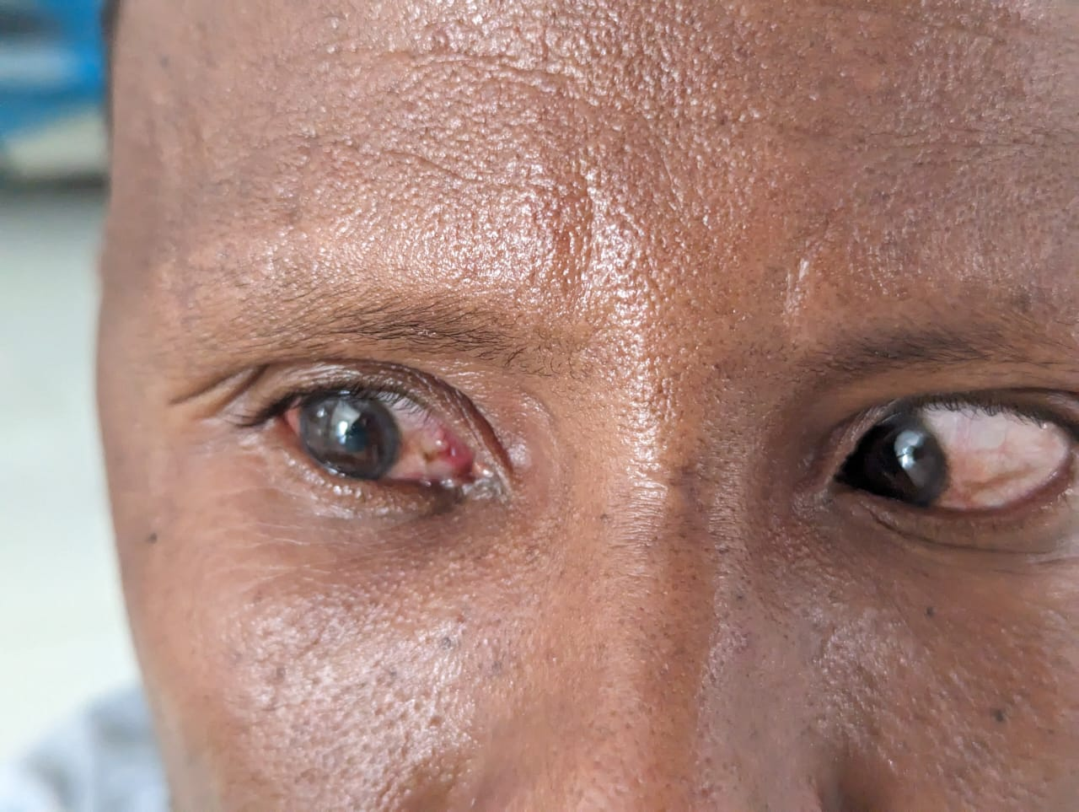

Slide 20
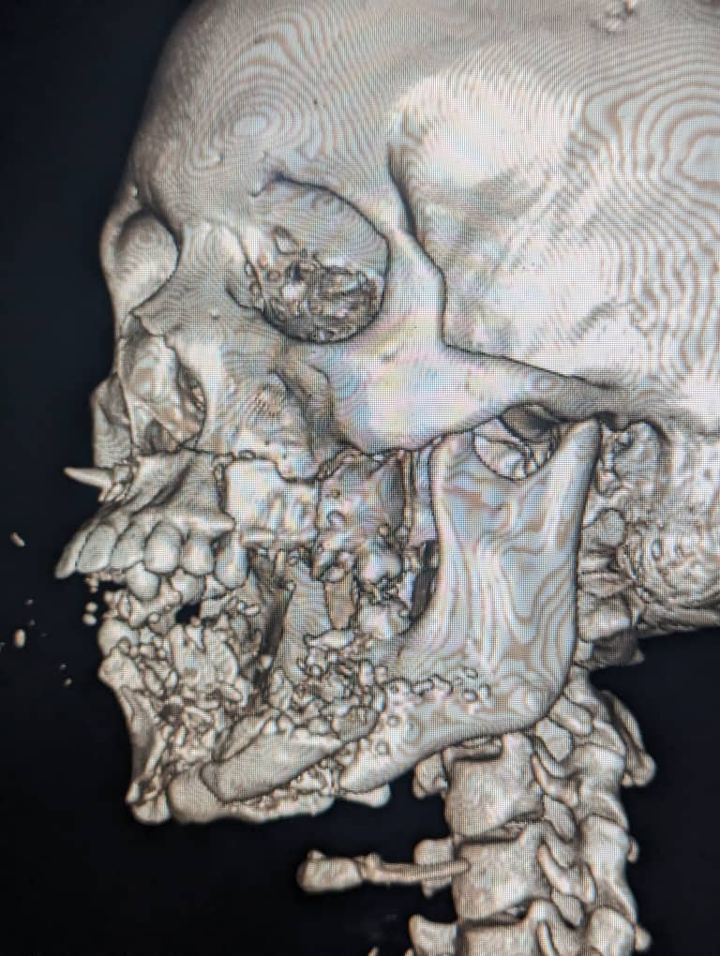

Slide 21
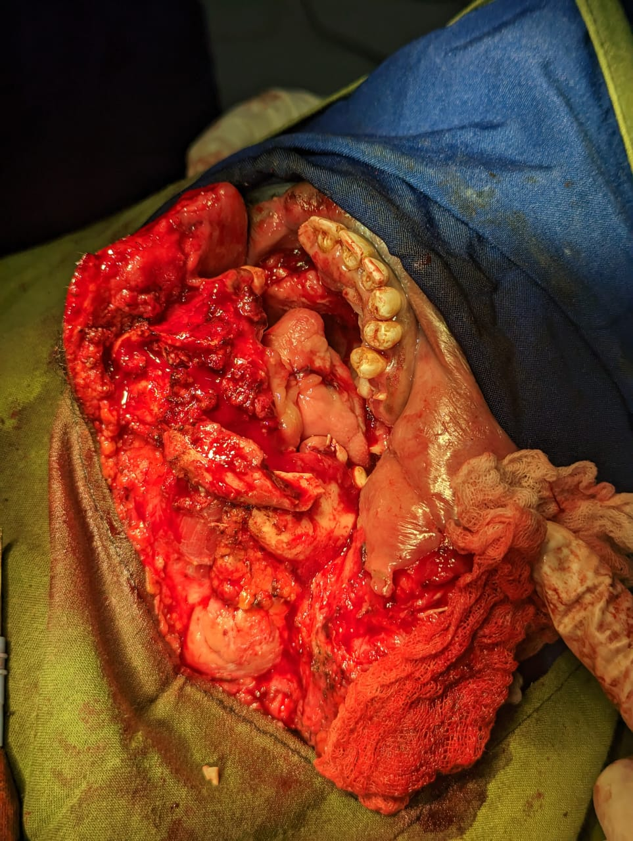

Slide 22
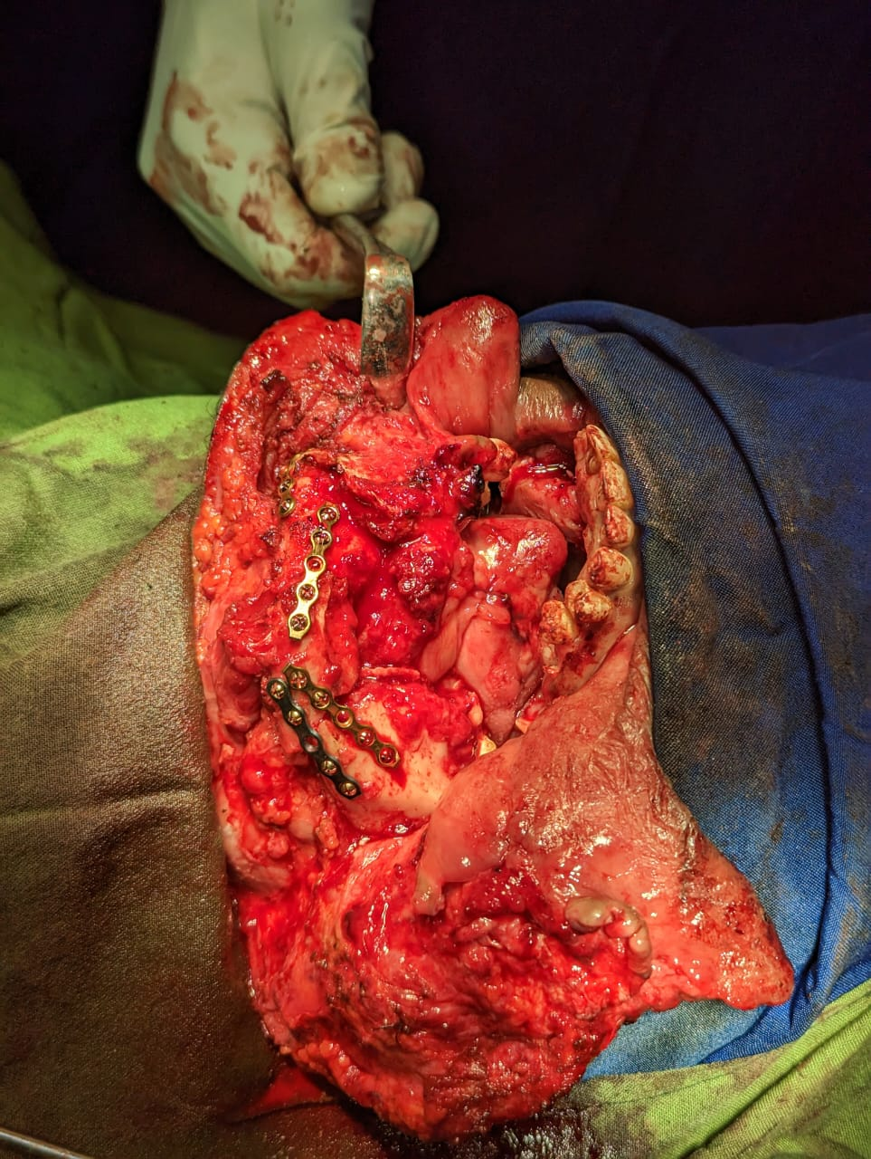

Slide 23
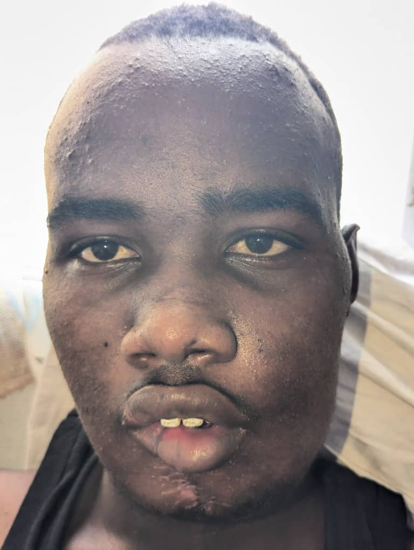

Slide 24
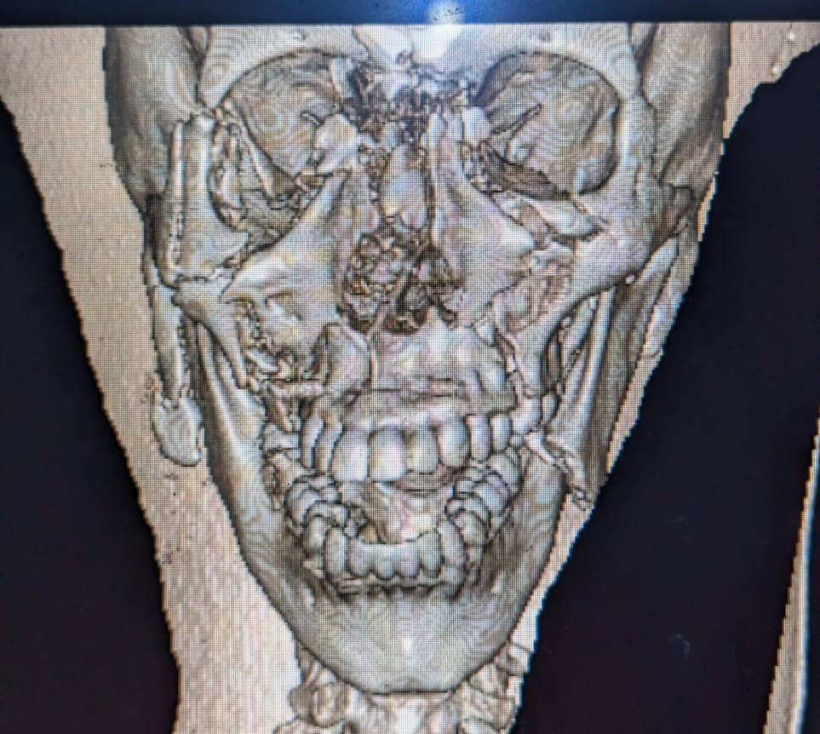

Slide 25
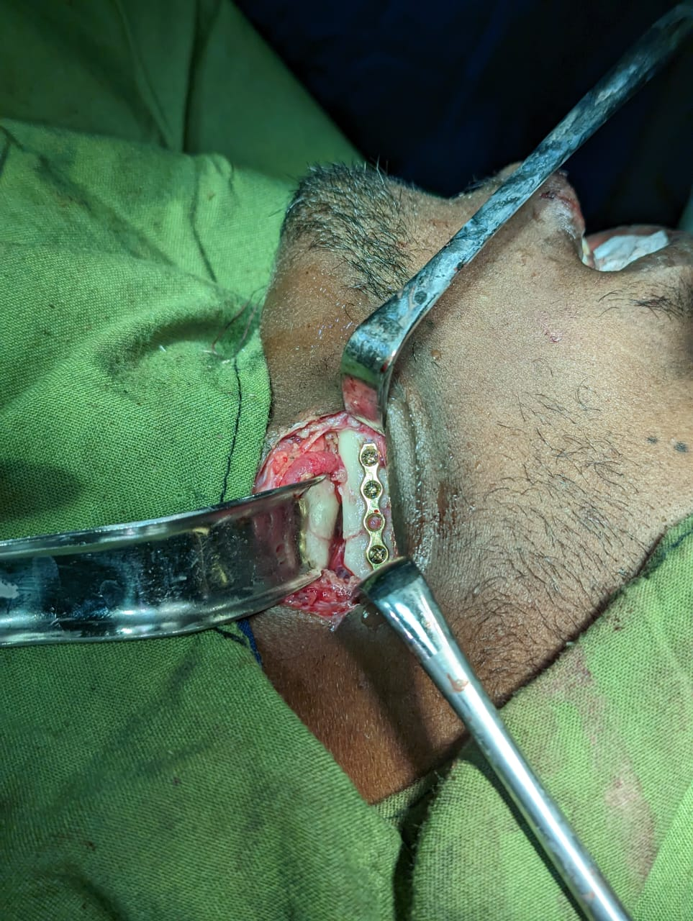

Slide 26
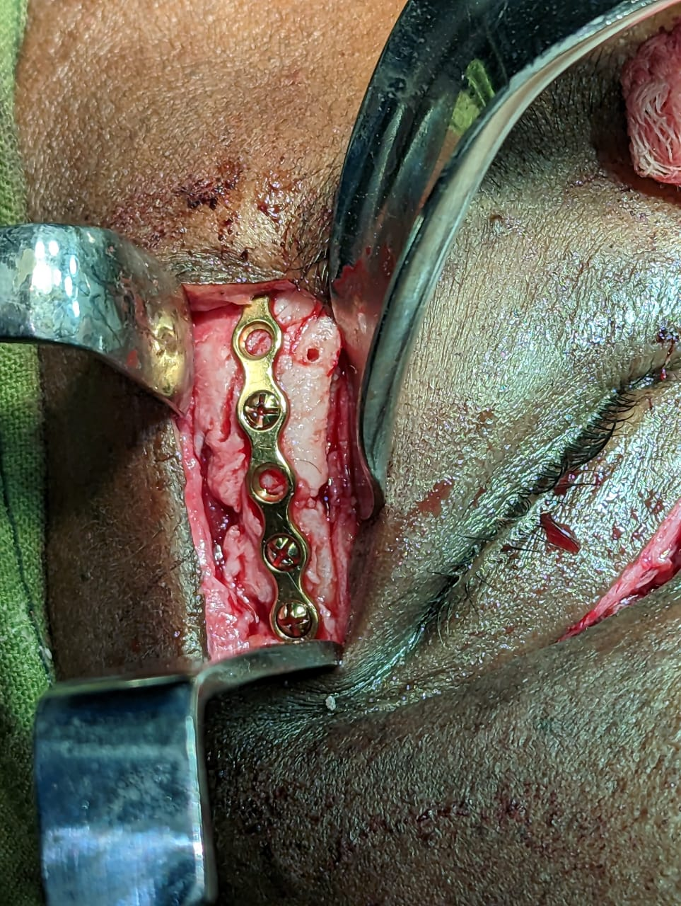

Slide 27
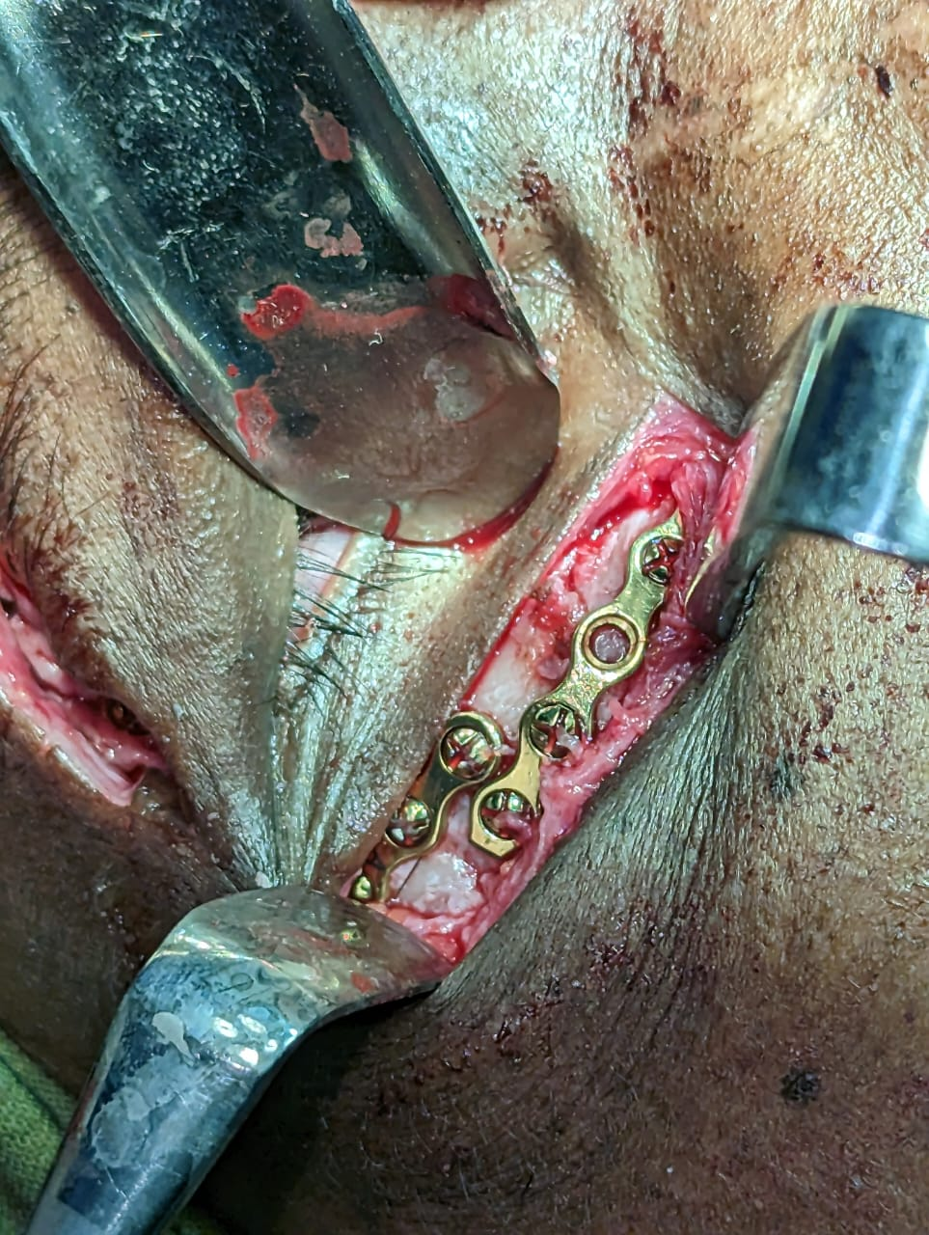

Slide 28
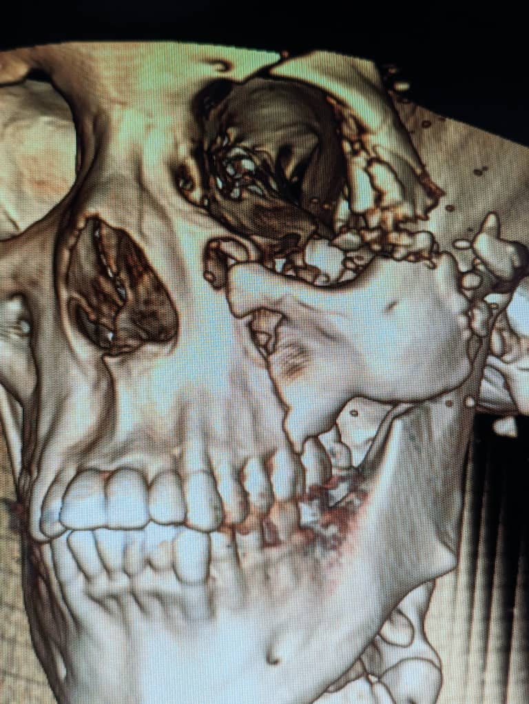

Slide 29
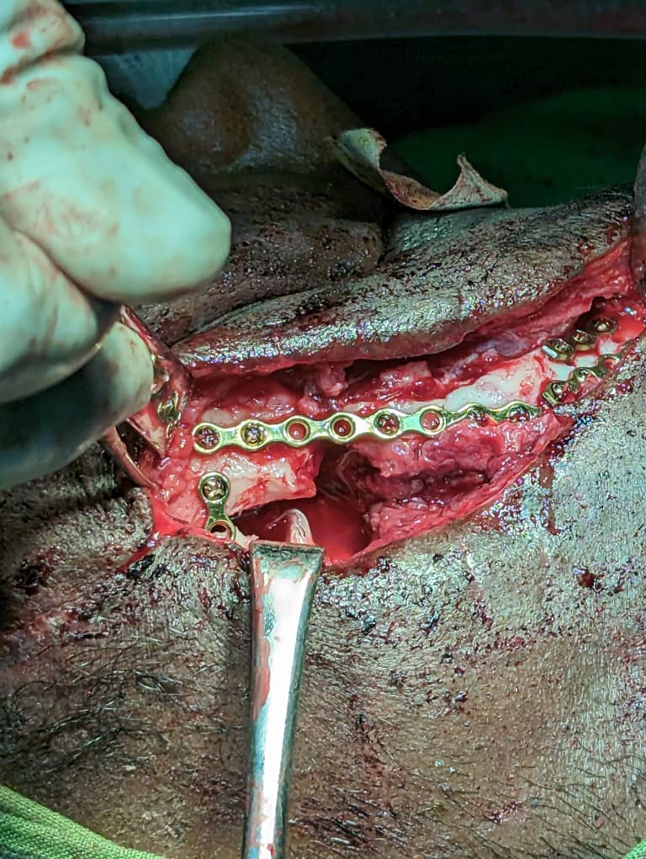

Slide 30
